Slide 1
Move your Feet Keep the Beat
Team - 8

Slide 2
Agenda
01
04
02
05
03
06
Team Introduction
Findings
Project introduction
Visualization-Story
Project Objectives
Summary & recomendations

Slide 3
Team Project Beat
Tanner Hunter
Madison Lusane
Jordon Moses
Corine Alida
Bose babu Ravula

Slide 4
02
Project Introduction

Slide 5

Risk Factors for Heart Disease
Physical factors
Behavioral factors
Early detection

Slide 6
03 Project Objectives
Why and what are the objetives?

Slide 7
Prevention of Heart disease
Develop a model to predict the cause
Improve the chances of preventive care

Slide 8


Model(s) Used are:
Logistic Regression
Random Forest

Slide 9
04 Findings

Slide 10
Does heart disease affect physical or mental health more?
People with physical health issues are more likely to develop heart disease than those without these conditions.
Mental health problems such as depression and anxiety are also more likely to develop in people with heart disease.
In our study, we found that those with mental health issues are 14% less likely to suffer from heart disease than those with physical health issues.
In order to promote overall health and well-being, it is important to address both mental and physical health concerns in people with heart disease.

Slide 11
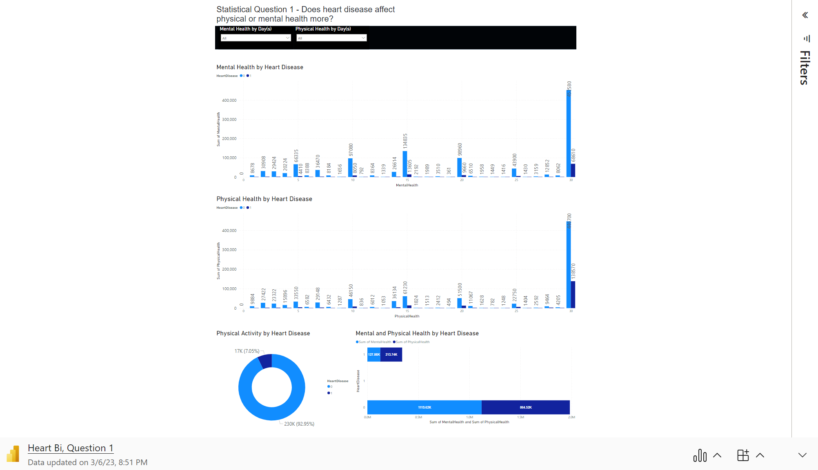

Slide 12
Does smoking influence contracting heart disease at younger vs older age?
Based on our findings, younger people are less prone to heart disease compared to older people as smokers.
The smoker's older generation is more subjective to heart disease due to the fact that they have been smoking long term. Therefore, there is no correlation between smoking and heart disease.

Slide 13
Predict which age group is prone to Heart Disease
Age groups who are crossing 50+ are more prone to heart disease when compared to the younger than 50.

Slide 14
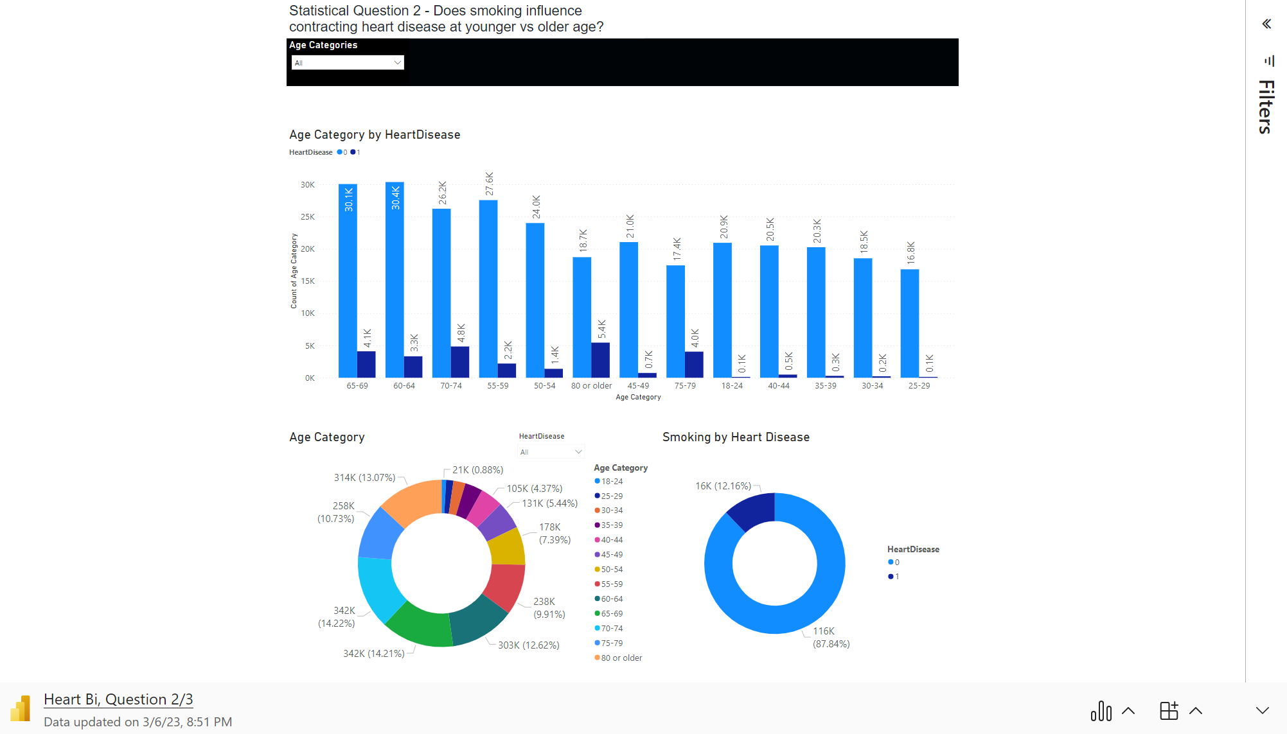

Slide 15
BMI and Difficulty in walking are correlated…Are they independent variables?
BMI and Difficulty walking are not correlated, thus they are independent variables. If a person has difficulty walking, they are more prone to have heart disease rather than someone with a higher BMI.
A high BMI can indicate high body fatness. BMI screens for weight categories that may lead to health problems, but it does not diagnose the body fatness or health of an individual.

Slide 16
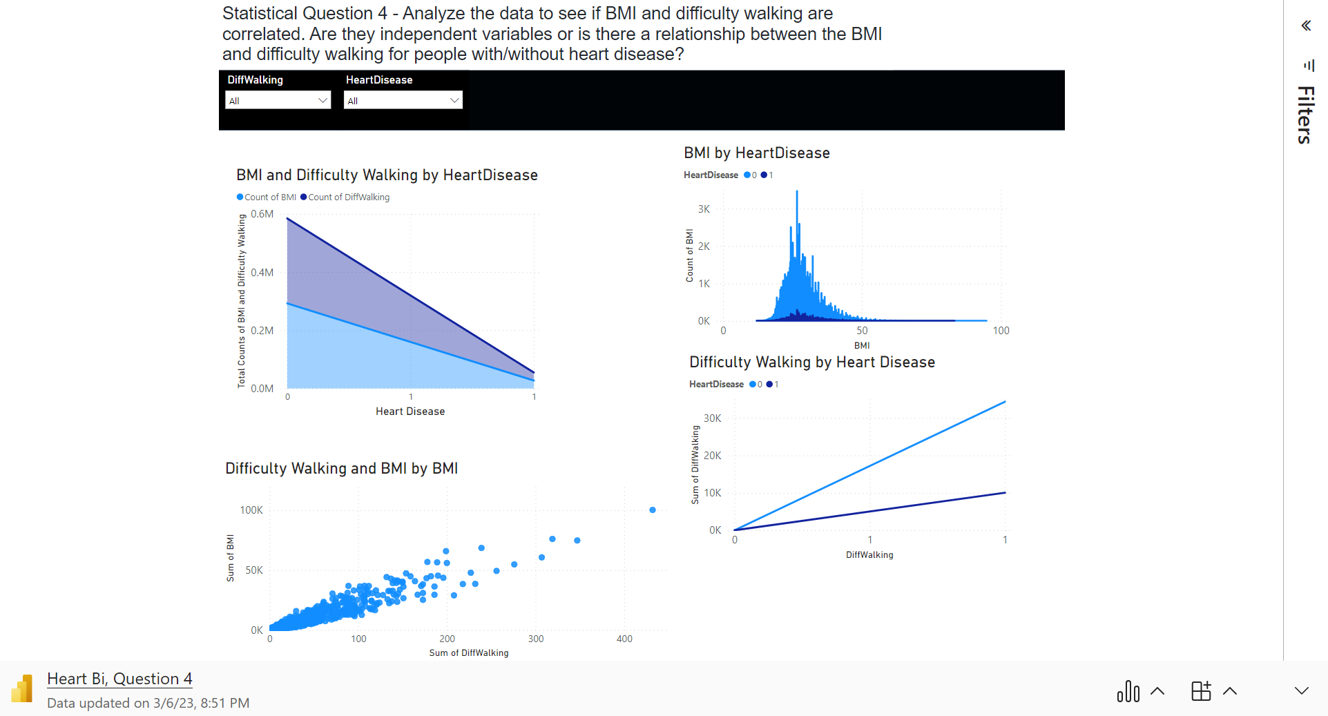

Slide 17
Demographics vs Heart Disease
Diabetes is the number one factor among the population that can lead down the line to Heart disease
The white population is more impacted by heart disease compared to other ethnic groups in the US.
The male population is 59 % impacted by Heart disease compared to the female population..

Slide 18
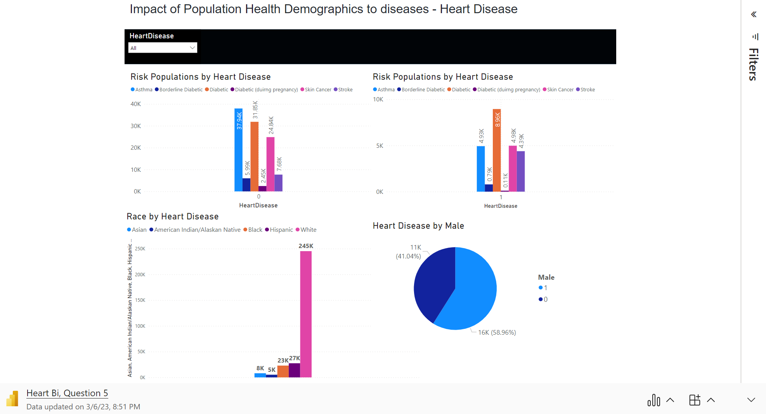

Slide 19
05 Visualization
01
Objective 1
02
Objective 2
03
Objective 3
04
Objective 4
05
Objective 5

Slide 20
06 Summary & Recommendations

Slide 21

Physical activity helps to reduce the chances of heart disease
Avoid Diabetes
Both Mental health and Physical well
being are equally important
Behavioral factors to avoid
Smoking/ Drugs
Drinking

